Slide 1
Predicting Avian Patterns
By The Bird Brains

Slide 2
The Team
01
01
Lynn Jacobs
02
Aluri Sri Moukthika
03
Jeffrey Cris
04
Gayathri Gandham
Confidential

Slide 3


Motivations and Background
Project FeederWatch
Species abundance and distribution observed in winter
Citizen science project
Bird presence reflects climate, habitat, and urbanization
factors.
Bird watchers and ecologists benefit from this project
Understanding species presence helps monitor
ecosystem health and guide conservation.
Confidential

Slide 4
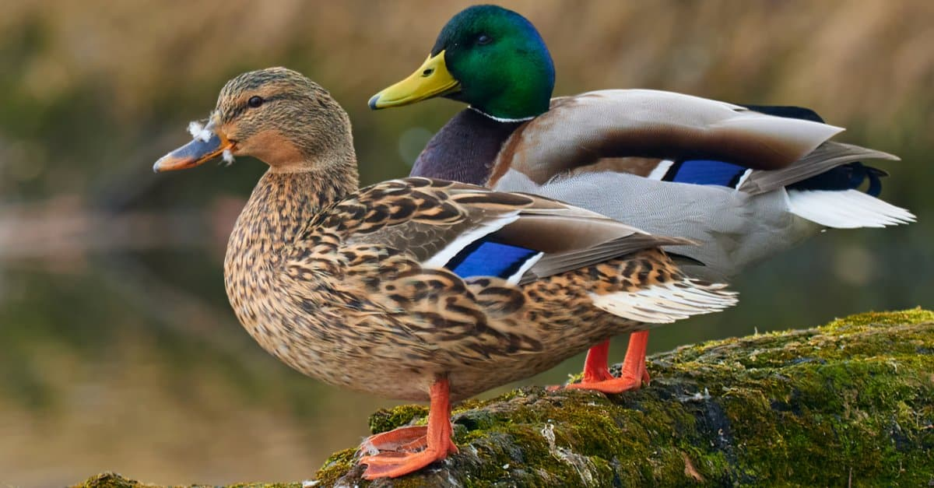
Problem Statement
Can we predict whether a Mallard will be present at a feeder site on a particular day?
Mallards are indicators of wetland + urban water ecosystem health
Presence patterns help understand habitat suitability, climate trends, and human–wildlife interaction
Site-level features (yard type, habitat, urban density)
may influence presence
A predictive model reveals which factors are most influential
Confidential

Slide 5
Data Science Pipeline
Data Preparation and Cleaning
Collected data from Feederwatch
Preprocessing: Imputed missing values and combined. Excluded suspicious values.
Feature Engineering: Cramer’s V considered. We selected the 20 top features using mutual information values
Scaling and Sampling
Modeling: Random Forest, KNN, Logistic Regression, Decision Tree
Evaluation: Confusion matrix.
Feature Selection
Model Selection
Model Evaluation

Slide 6
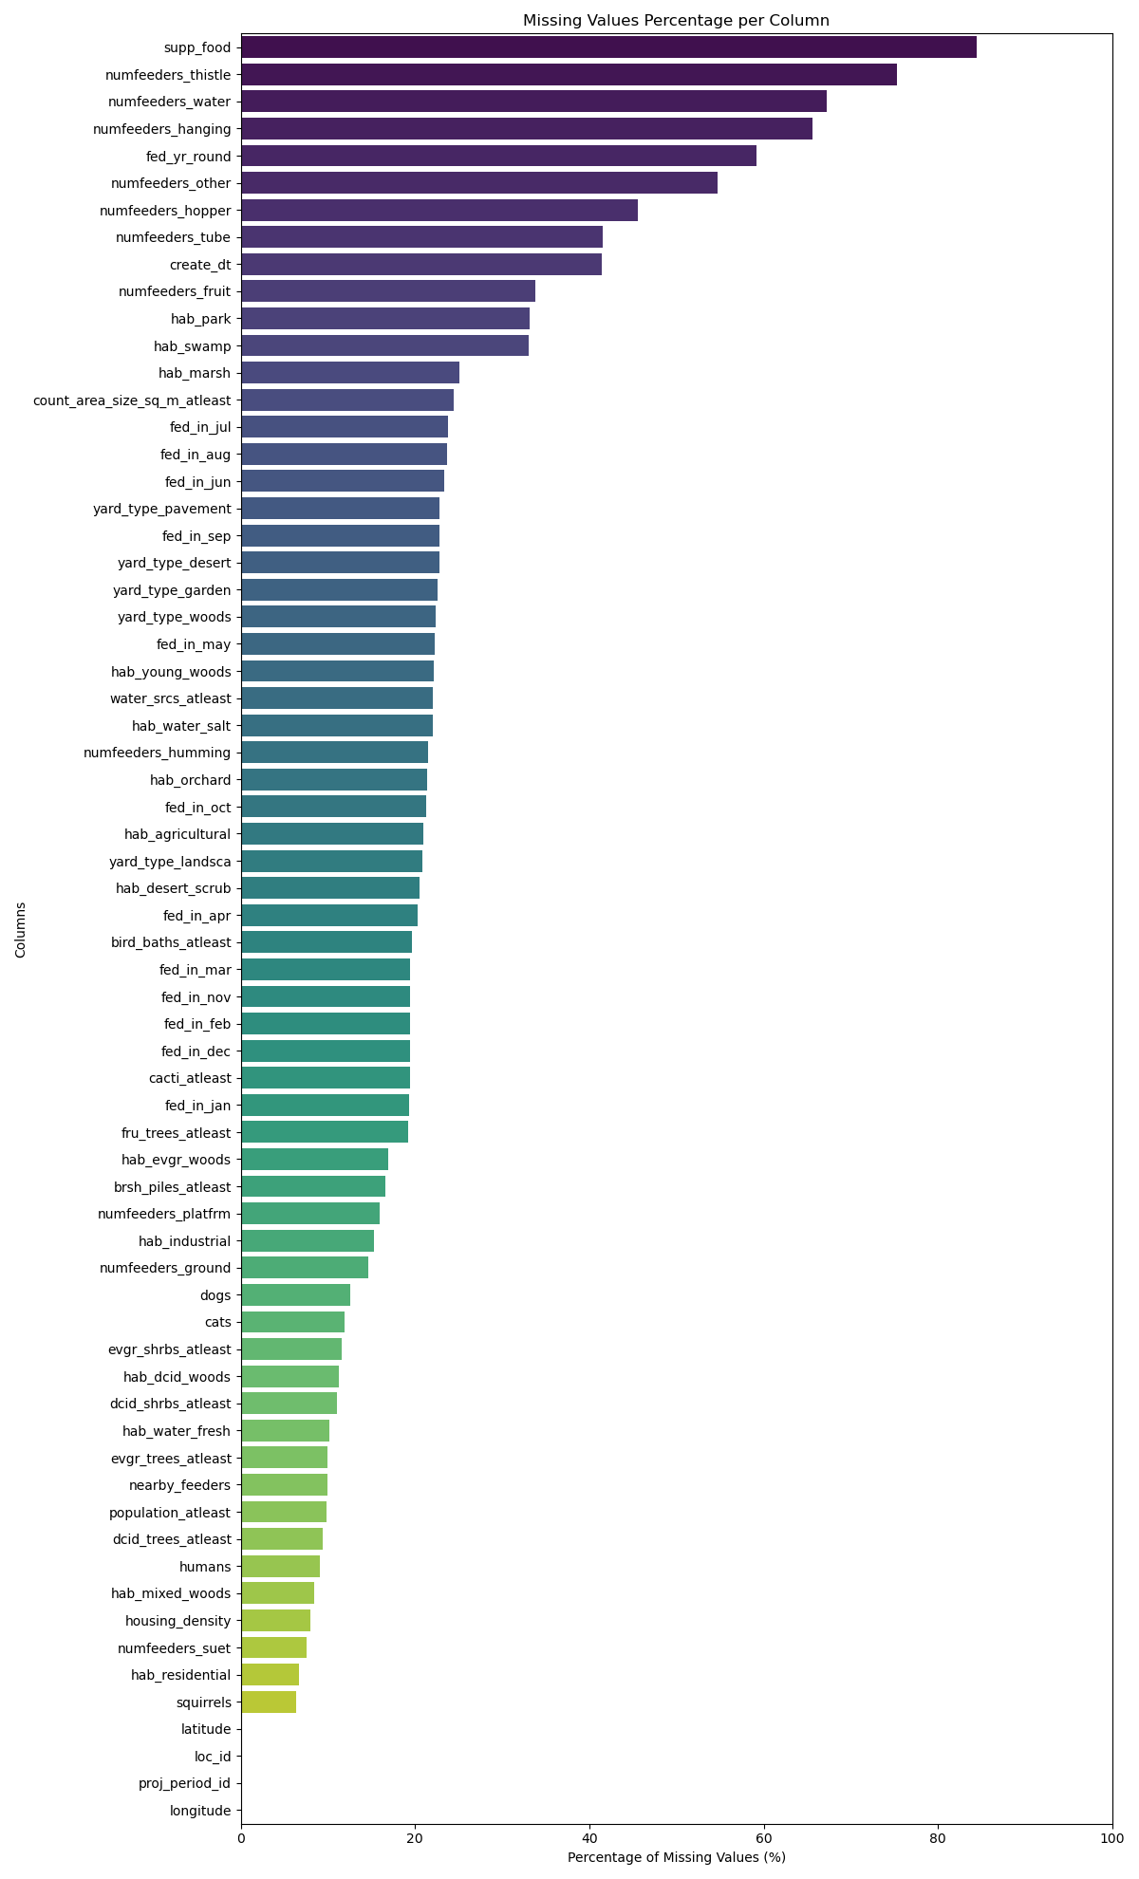
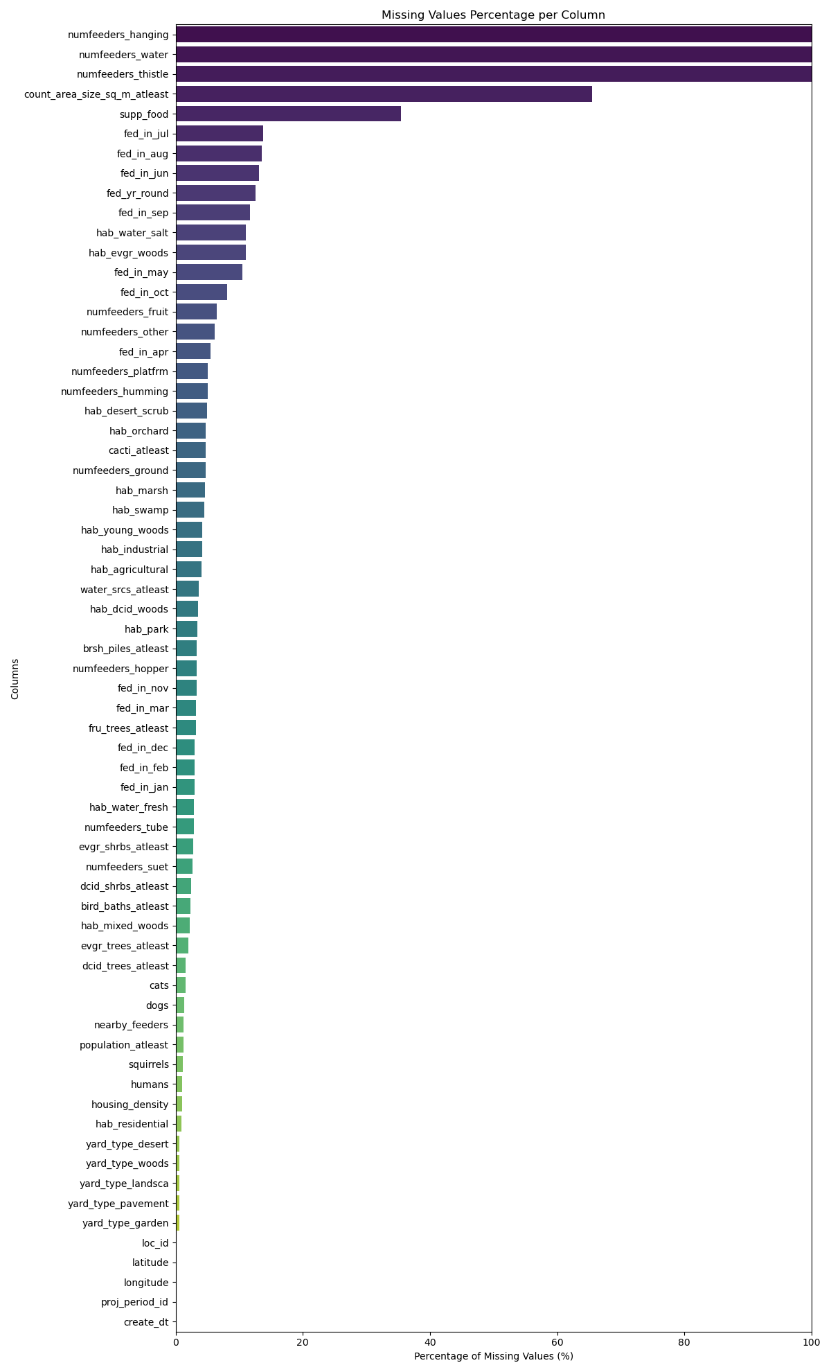
Methodology
Data Cleaning
Dataset Used: 2020 - 2024
Observer Table — 1 million rows × 24 columns (observer details, date, time, effort)
Site Description Table — 3 thousand rows × 66 columns (yard type, site attributes)
Removed unreviewed/invalid rows from the Observer Table
Removed the entries for other years from the Site Table
Missing value % of ST before
Missing value % of ST after

Slide 7
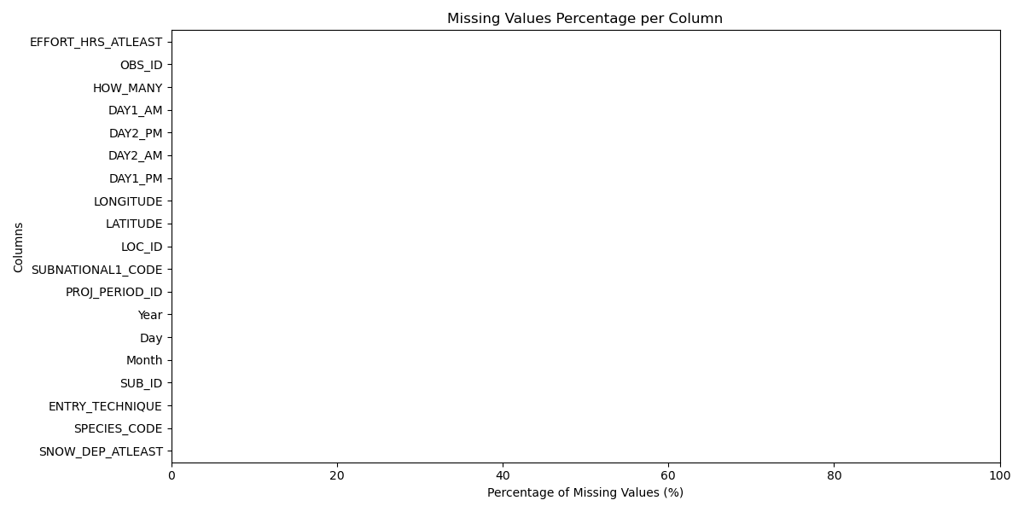
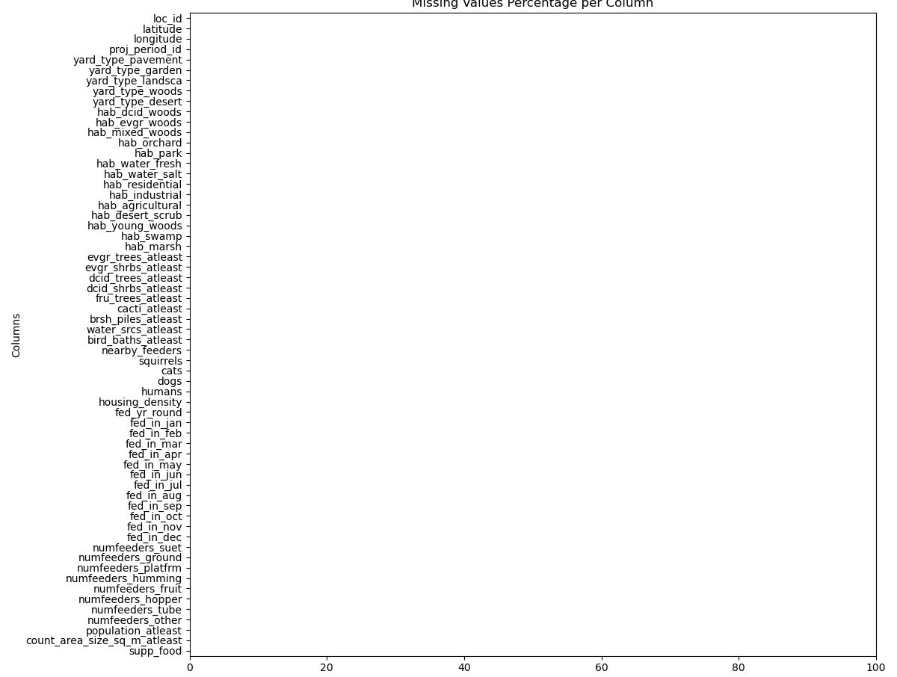
Missing Data Handling
Dropped all features with >75% missing values
Imputation Strategy
1. Binary Features (0/1)
Impute: Mode (best for categorical binaries)
2. Ordinal Habitat Scores (0,1,3,4,11)
Ordered categories (none → low → high → very high)
Impute: Median (preserves order)
Observer Table
Site Description Table

Slide 8
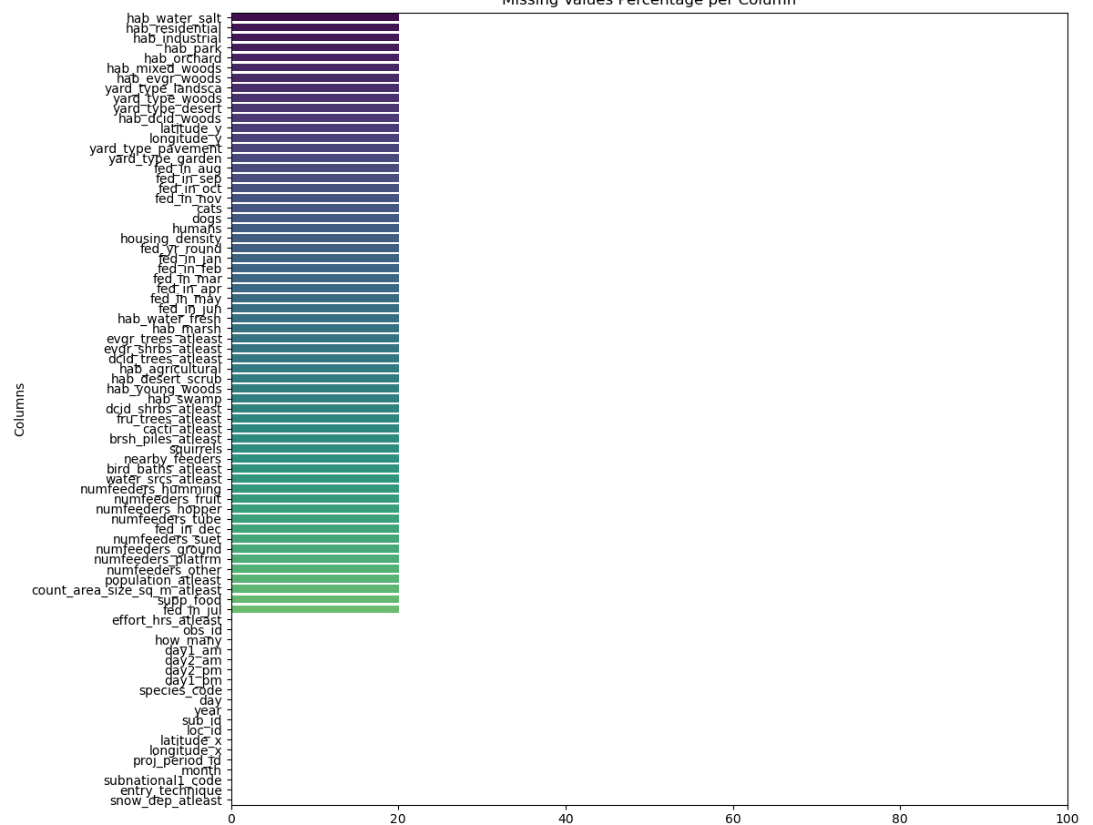
Table Merge & Post-Merge Imputation
• Table Merge
Merged Observer Table and Site Description Table
Keys used: location_id, latitude, longitude, proj_period_id
• Post-Merge Missing Values
Merge introduced a small amount of missing data (<20% per column)
• Imputation Strategy
Numeric columns: Median imputation
Categorical columns: Mode imputation
Saved the final cleaned dataset for modeling

Slide 9
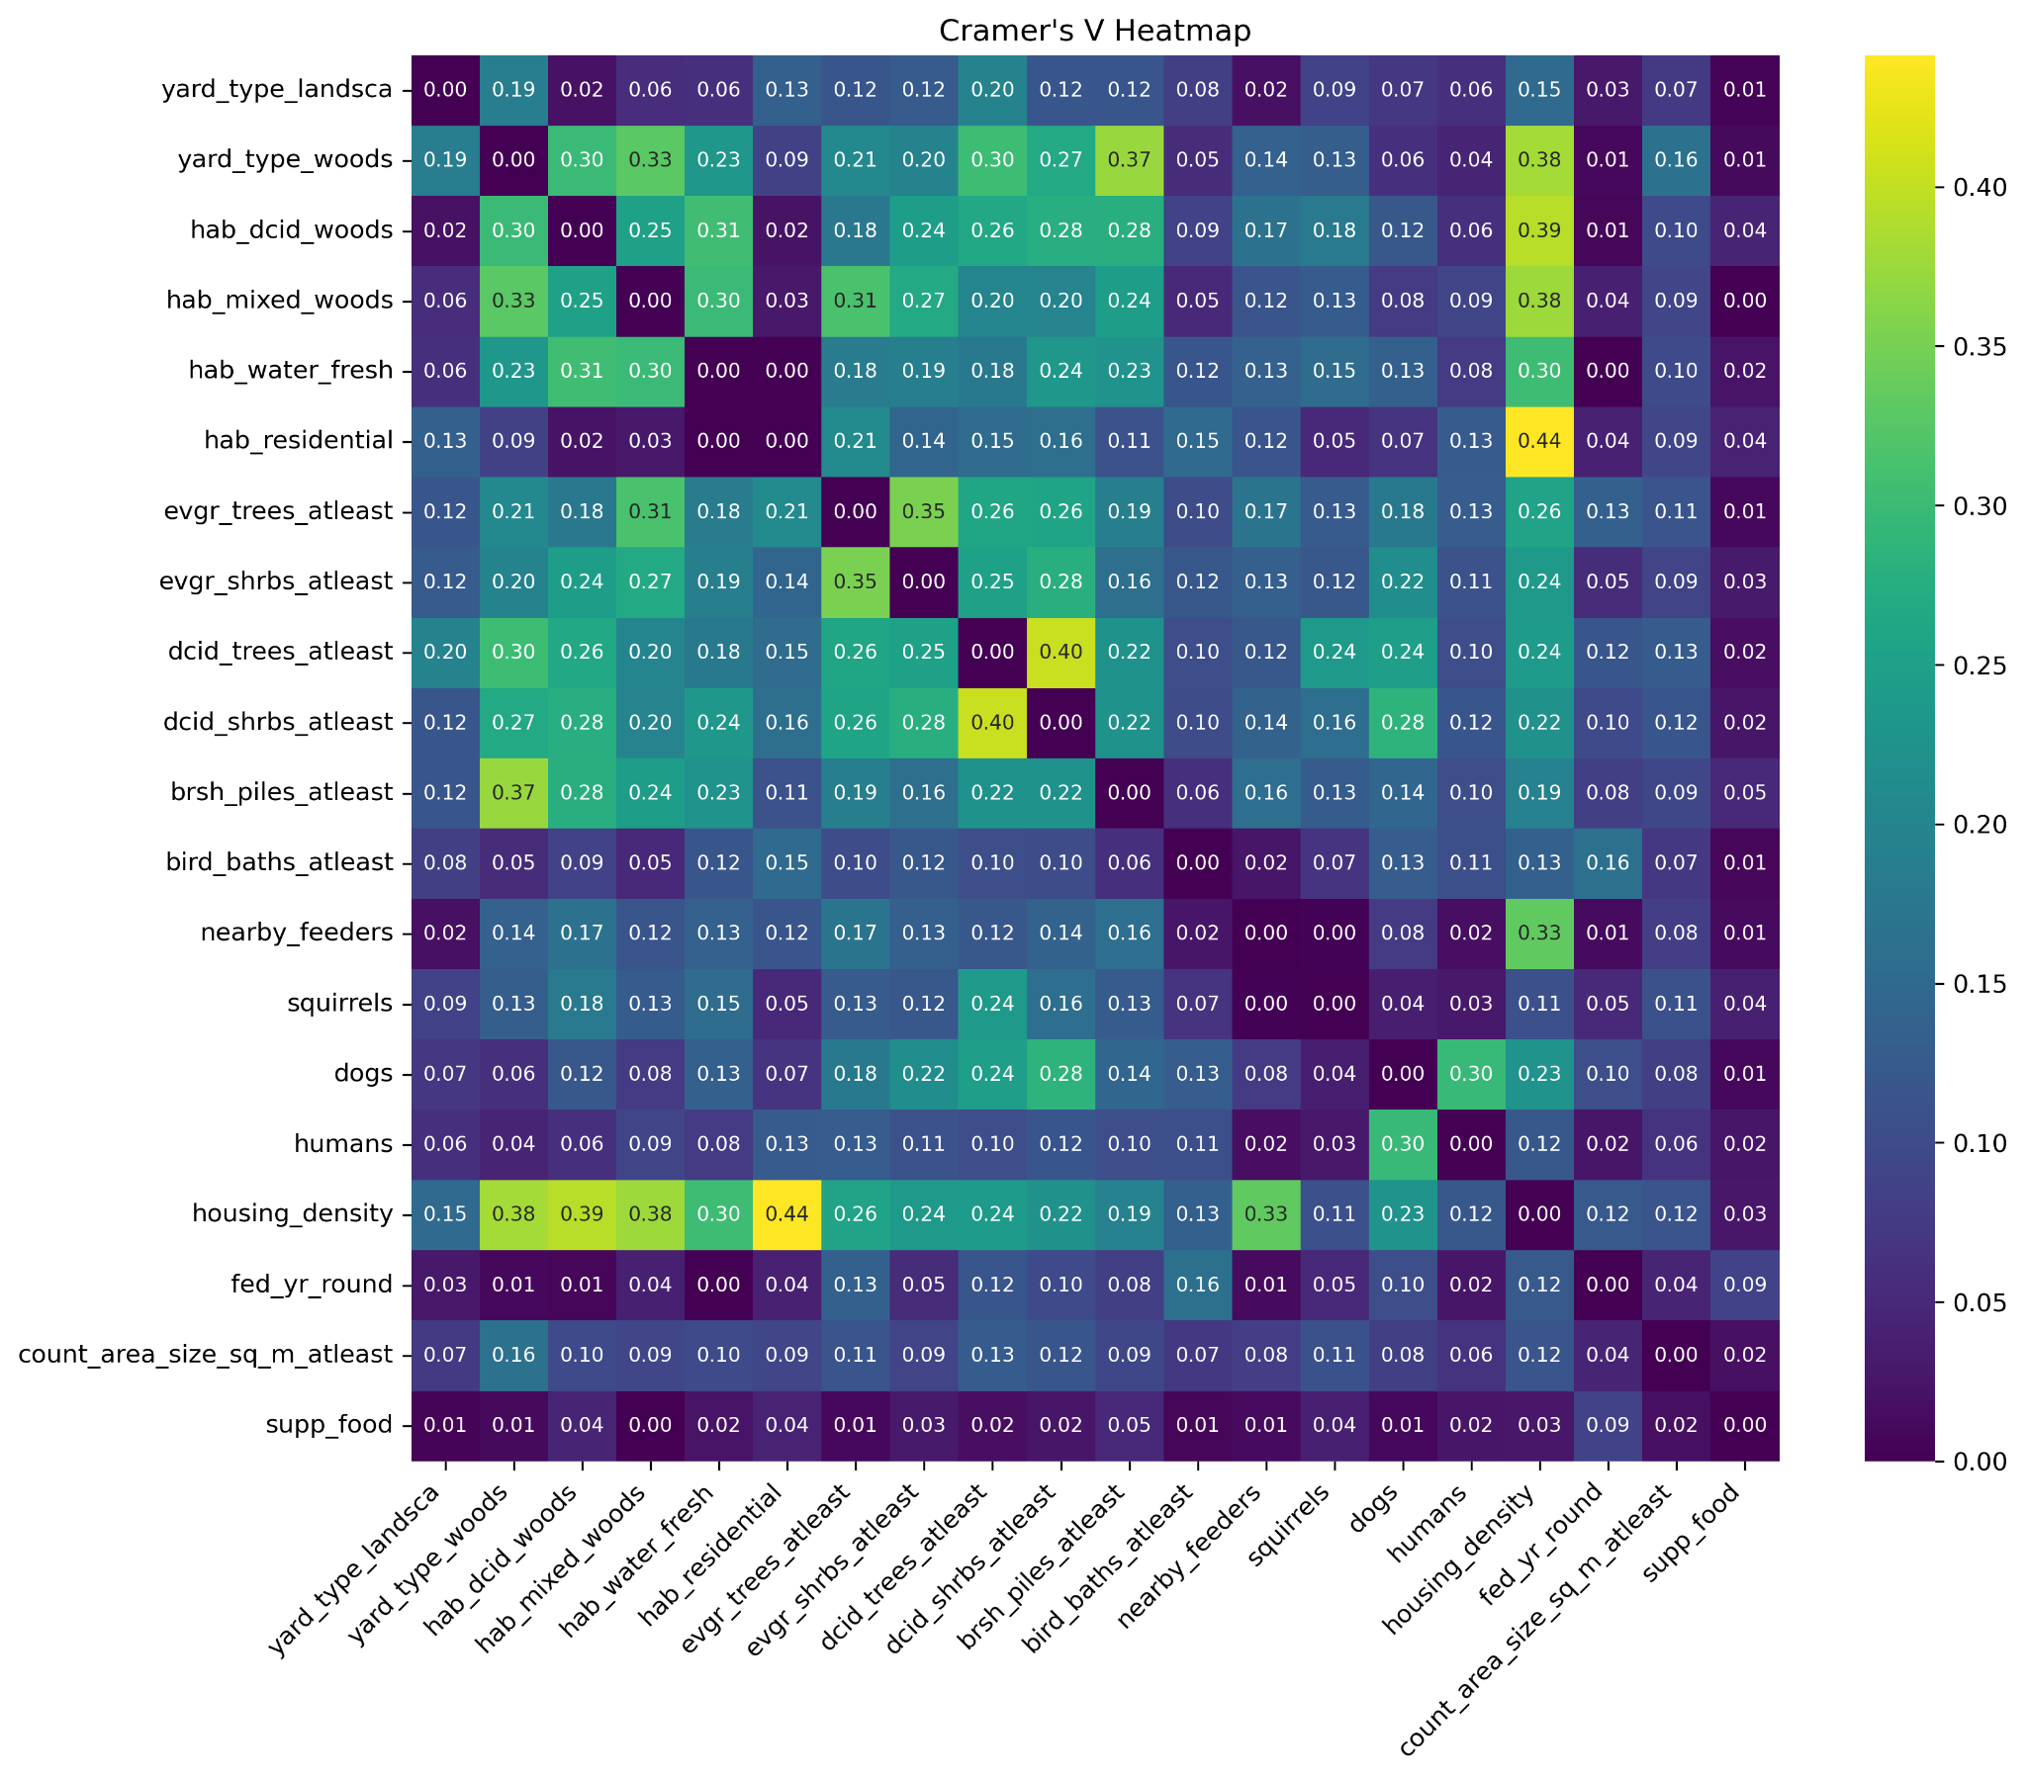
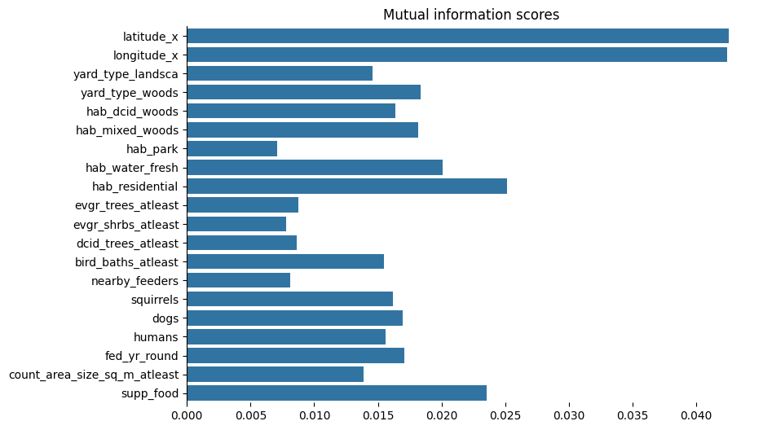
Feature Selection:
Computed Cramér’s V correlation matrix for all features
No feature pair showed correlation > 0.85 → all features informative
Dropped housing_density and dcid_shrubs_atleast
For each group, plotted Mutual Information Scores to measure each feature contribution
Final 20 features chosen based on highest MI impact + model performance
Cramer’s V Correlation matrix
Mutual Information Scores

Slide 10
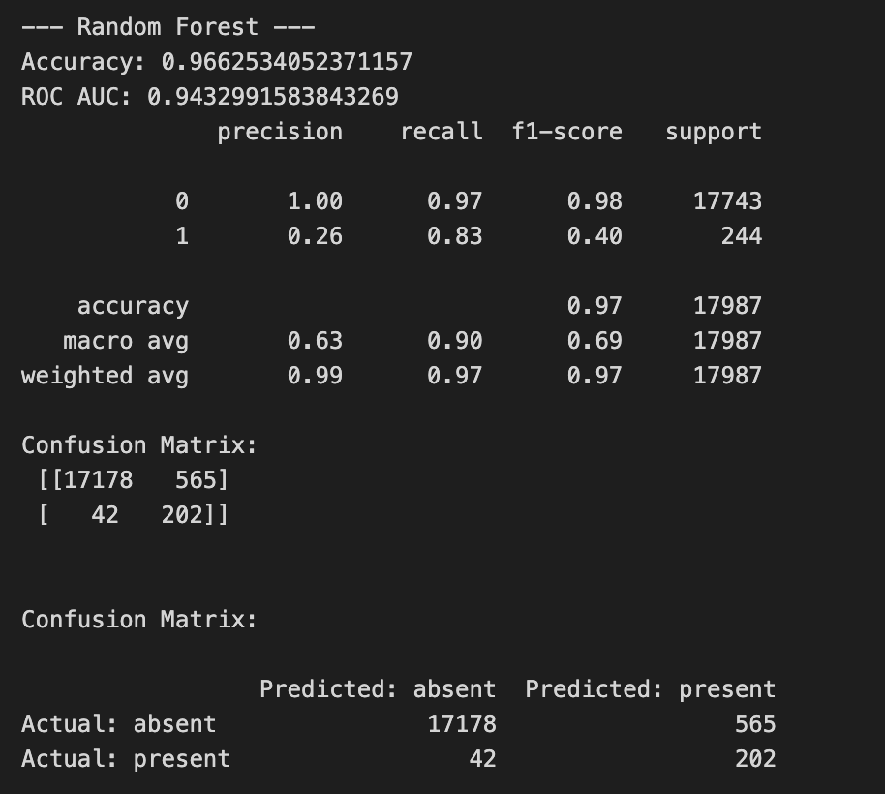
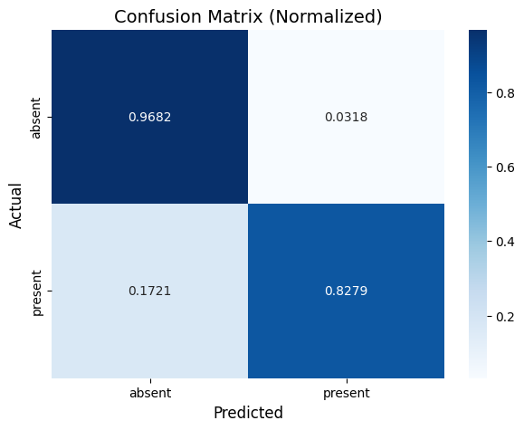
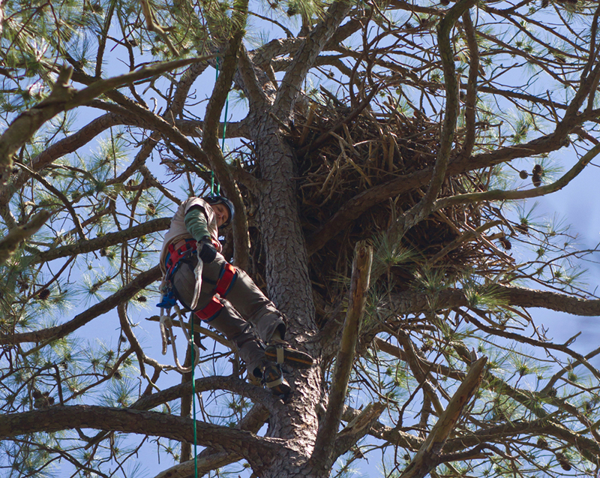
Evaluation of Best Model: Random Forest
We focused on evaluating recall and accuracy, not precision and f1 score.
False positives are not as bad as false negatives here
Used SMOTE for resampling the training data because of our highly imbalanced data set
SMOTE over-samples from the presence data points
A crazy birder climbing to see an osprey nest
Confidential

Slide 11
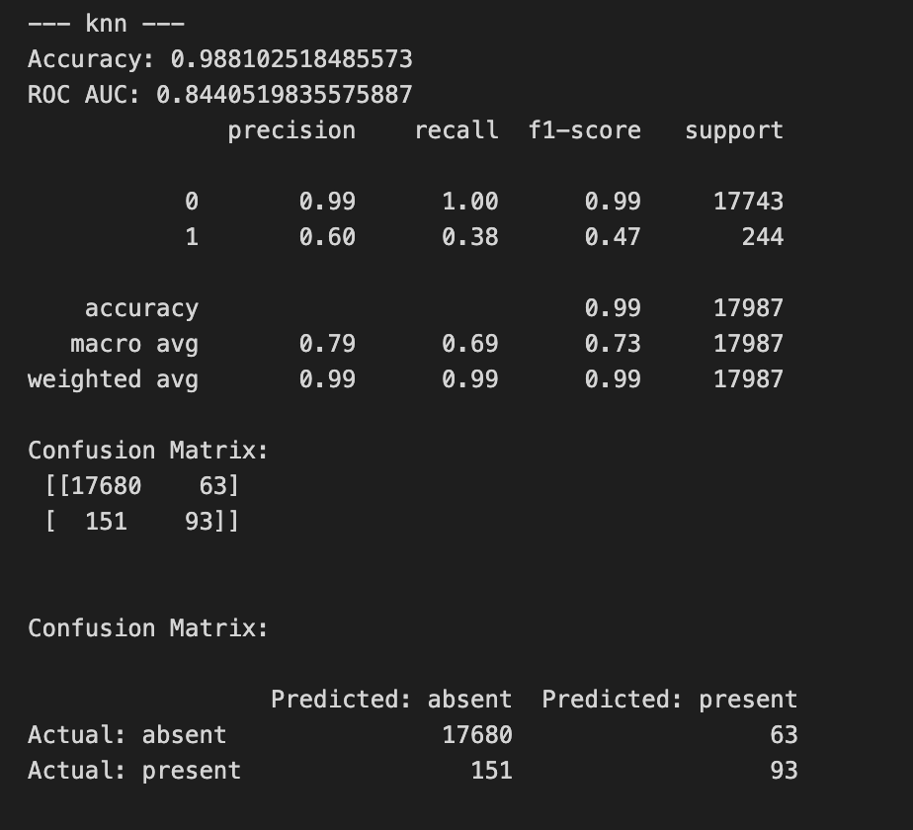
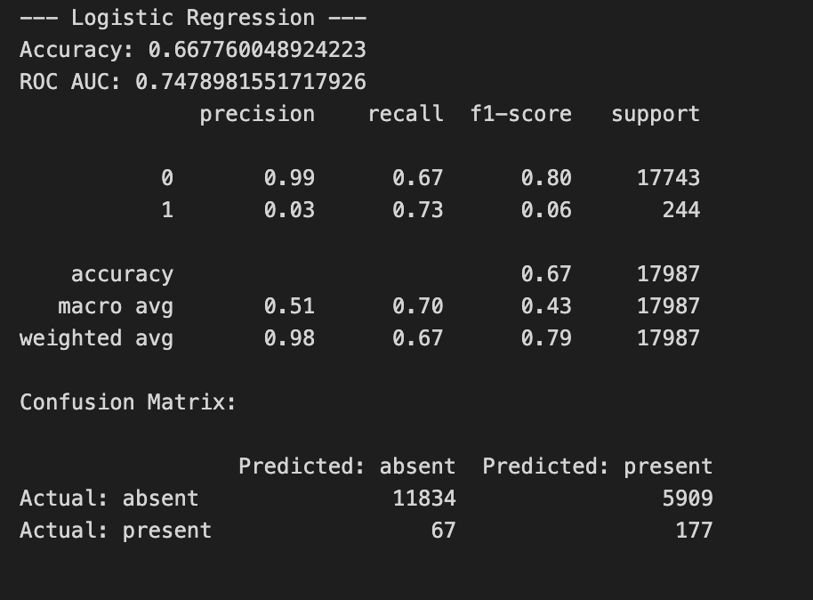
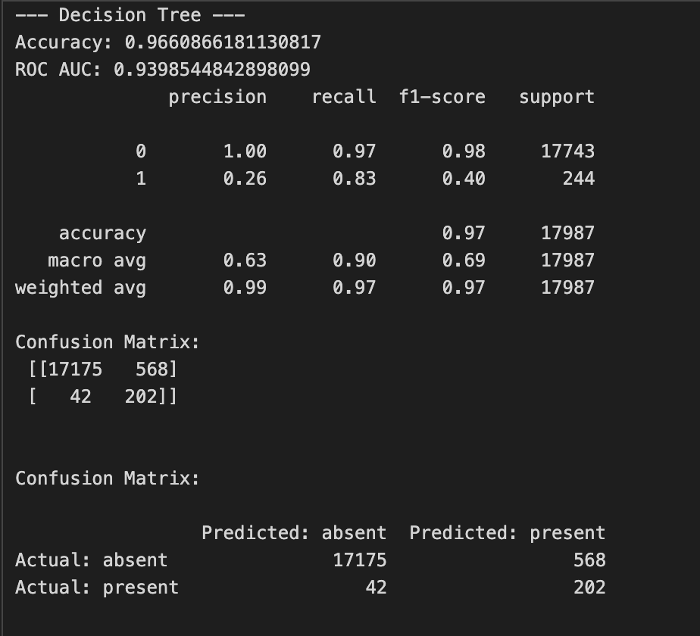
Other models’ scores
Confidential

Slide 12
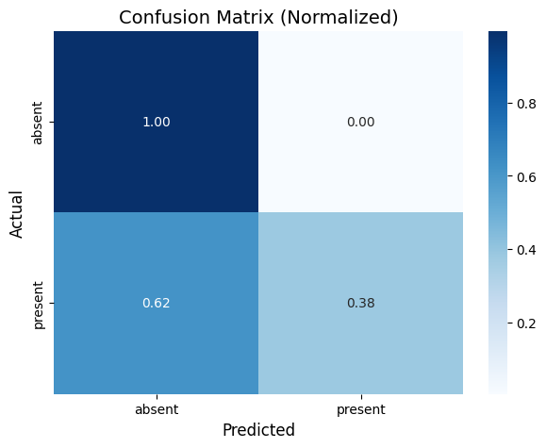
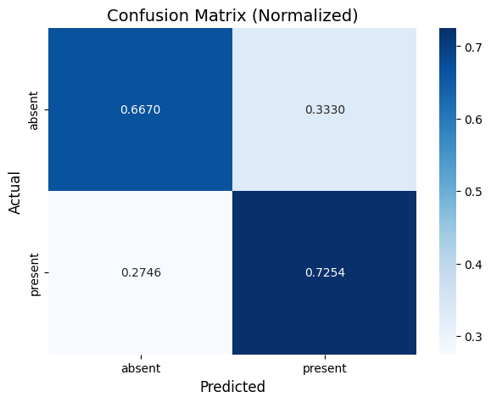

Other models’ confusion matrices
Knn
Logistic Regression
Decision Tree

Slide 13
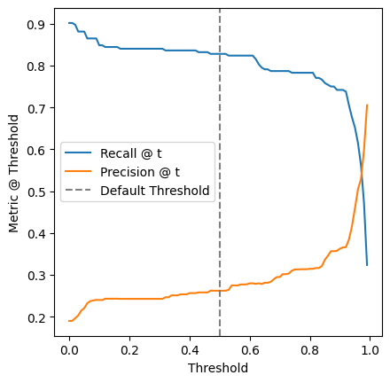
Considering Tuning By Recall Threshold
We decided not to set a different precision/recall threshold after viewing this graph.
If we cared even less about precision, we could set a lower threshold
Setting a different threshold might be useful for predicting other bird species

Slide 14
Lessons Learned
Handling data imbalance using a resampler.
The order of resampling and specifically on the training data.
Collaborated by dividing tasks and leveraging each team member’s strengths.
Narrowing down on a particular species to cut down the complexity of the project.

Slide 15
Summary
Goal: Predict presence of Mallard (mallar3).
Combined two datasets and cleaned/standardized features for modeling.
Key predictors included: latitude/longitude, yard and habitat types, vegetation structure, supplemental food, and presence of humans/animals.
Trained four models: Logistic Regression, Decision Tree, Random Forest, KNN.
Random Forest performed best, capturing complex feature interactions.
Findings show habitat features strongly influence Mallard presence.

Slide 16

ANY QUESTIONS?

